Slide 1

Ecommerce Customer Retention

Slide 2
Project Overview
Ecommerce (electronic commerce) refers to all online activity that involves the buying and selling of products and services. In other words, ecommerce is a process for conducting transactions online. When you go to your favorite online retailer to buy a new pair of shoes, you're engaging in ecommerce. The world is moving towards digitalization and that were the idea for Ecommerce comes into the picture.
Sales determine a company’s success and profitably. While the world of Ecommerce is highly competitive Customer satisfaction has emerged as one of the most important factors that guarantee the success of online store; it has been posited as a key stimulant of purchase, repurchase intentions and customer loyalty.
In this project we study the factors that trigger a customer to refer a particular shopping website to his friend, which would be an outcome of his satisfaction towards a particular Ecommerce Website.

Slide 3
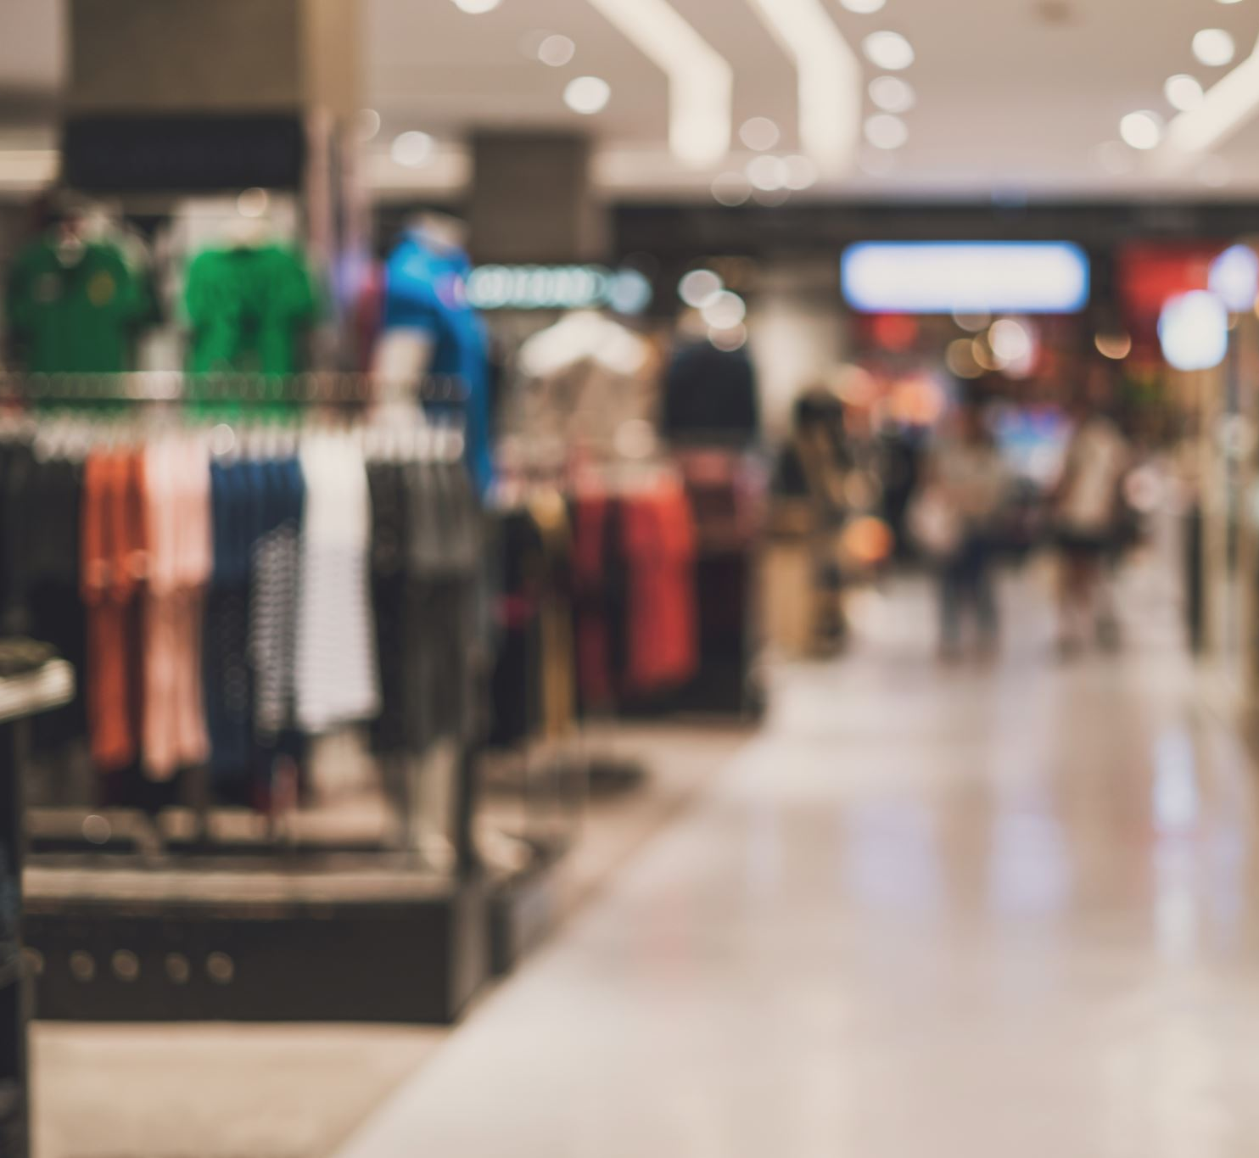
Problem Statement:
The goal is to create a model that would determine which website depending on a customers preferred choice for shopping would he refer his friend.

Slide 4
Steps:
Pre-Processing
Data Cleaning
Encoding Categorical Variables
Balancing the dataset
Model Training
Feature Scaling
Model 1: LogisticRegression
Model 2: KNeighborsClassifier
Model 3: RandomForestClassifier
Model Evaluation
Evaluating the models using Accuracy Score, Cross-Validation Score
Finalizing The Model
Process to determine a model that has the least difference between the Accuracy Score and CV Score

Slide 5

Exploratory Data Analysis

Slide 6
Percentage Shoppers According to Sex
The Percentage of Female Shoppers are more than double that of the Male shoppers

Slide 7
Age Segmentation of Customers
We see that customers between the age group 30-40 shop the highest and customers in the age group 51 and above shop the least

Slide 8
City
We see that people from Delhi and Greater Noida shop the most and people from Moradabad and Bulandshahr shop the least.

Slide 9
Since How Long You are Shopping Online ?
We see that the highest number of customers in the dataset have been shopping over 4 years and the lowest for 1-2 years

Slide 10
Online Purchases Made in Last 1 Year
We see that the dataset contains highest number of customers who have shopped less than Less than 10 times and lowest are the customers who have shopped 42 times and above.

Slide 11
Which channel was used to arrive at your favorite online store for the first time?
We see that majority of the customers in the dataset arrived on the website for the first time from Search Engines and the least from Display Adverts, hence the data can be used for insights on ads expenditure

Slide 12
After first visit, how do you reach the online retail store?
The highest number of customers use Search Engine and application to shop while least are driven by Social Media.

Slide 13
Time Taken to Make Purchase Decision
We see that majority of the customers in the dataset browse more than 15 mins and he least for 1-5 mins, hence we should try to engage the customers for longer on the website so as to increase the chances of higher sales

Slide 14
Preferred payment Option
We see the majority of customers prefer card payments and the least use E-wallets

Slide 15
Why did you abandon the “Bag”, “Shopping Cart”?
The biggest reason for customers abandoning the product is due to a better alternative option and the least abandon cause of No preferred mode of payment

Slide 16
What all online retailers you have shopped from
We see that most customers prefer multiple channels for shopping

Slide 17
Which of the Indian online retailer would you recommend a friend?
We see that a customer is more likely to refer Amazon followed Flipkart as the preferred website to his friend

Slide 18

Data Cleaning

Slide 19
Assumptions & Cleaning the Row’s and Columns
Column '3 Which city do you shop online from?' had Noida and Greater Noida which very close by and in the same district which were clubbed into Noida.
Column '6 How many times you have made an online purchase in the past 1 year?' had 41 times and above and 42 times and above which were clubbed into 41 times and above.
Column’s Dropped :
'4 What is the Pin Code of where you shop online from?’,
'Limited mode of payment on most products (promotion, sales period)’,
'Security of customer financial information’,
'Privacy of customers’ information’,
'Speedy order delivery ‘,
'46 Shopping on the website helps you fulfill certain roles’,
'44 Shopping on your preferred e-tailer enhances your social status’,
'43 Shopping on the website gives you the sense of adventure','41 Monetary savings’,
'36 User derive satisfaction while shopping on a good quality website or application’,
'29 Responsiveness, availability of several communication channels (email, online rep, twitter, phone etc.)',’
25 Convenient Payment methods’,
'24 User friendly Interface of the website’,
'12 Which channel did you follow to arrive at your favorite online store for the first time? ‘,
'9 What is the screen size of your mobile device? ‘,
'7 How do you access the internet while shopping on-line?',’
1Gender of respondent'] were dropped.

Slide 20
Pre-Processing
Since the dataset was imbalanced, we used SMOTE to balance the dataset.
Ordinal Encoder was used to encode the categorical variables
Standardization was performed on Independent Variables.

Slide 21

Model Training

Slide 22
A base model with Logistic Regression was set up to get the best Random State and CV.
Best Random State = 0 and all the cv returned a 100% score hence cv = 4 was taken for evaluation.
3 Models were Trained:
LogisticRegression
KNeighborsClassifier
RandomForestClassifier

Slide 23

Model Evaluation and Validation:

Slide 24
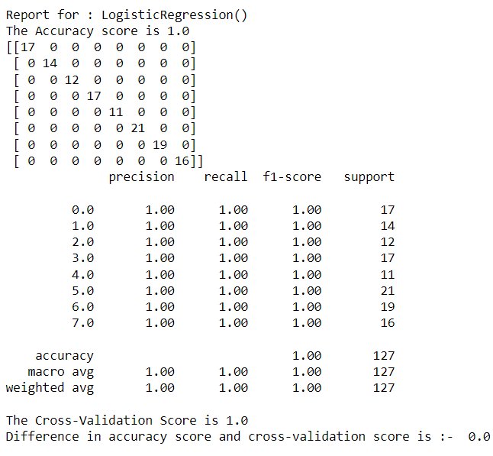
LogisticRegression

Slide 25

KNeighborsClassifier

Slide 26

RandomForestClassifier

Slide 27

Final Model

Slide 28
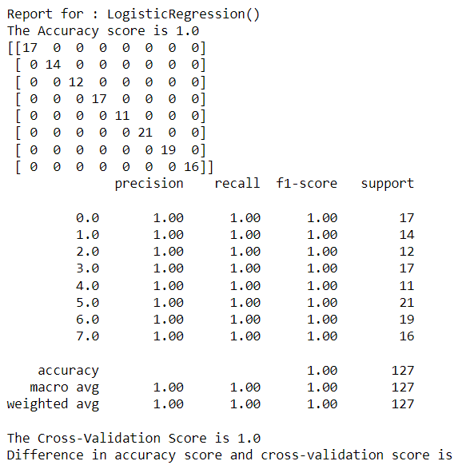
Logistic Regression

Slide 29

Conclusion

Slide 30
LogisticRegression was picked as the Final Model.
Since all the model’s returned an Accuracy and Cross-validation Score of 100% any model could be picked
No Hyper-Parameter Tuning was required as the best possible score was already achieved.
At last, the Final Model was saved using Pickle.

